Slide 2
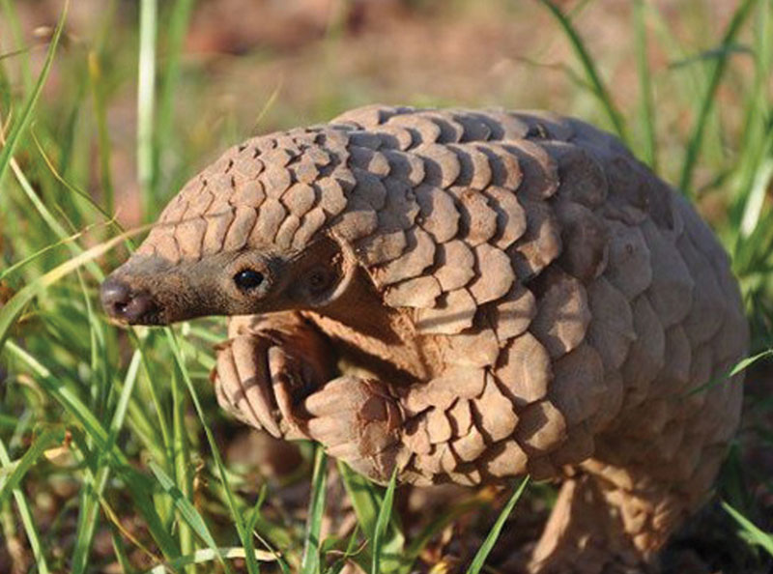
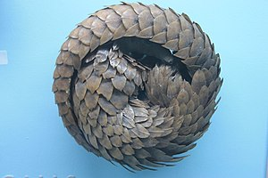
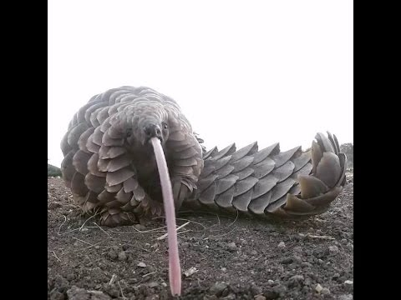
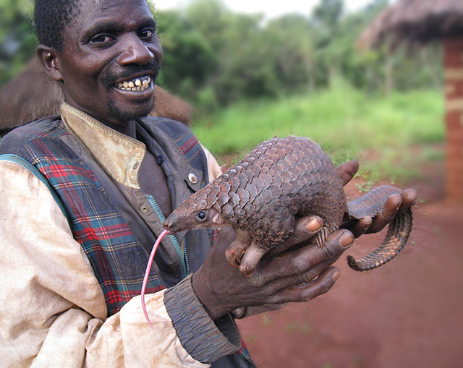
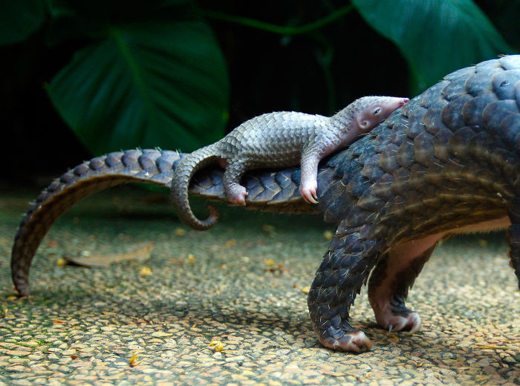
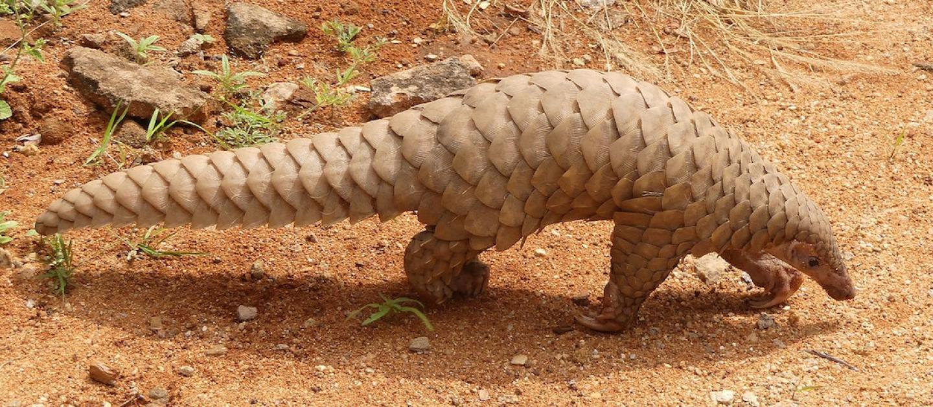
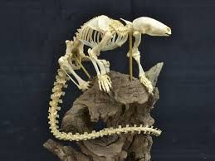
Ferae: Pholidota (8 sp)
Pangolins
Notes:
Four in Africa, four in Asia

Slide 3
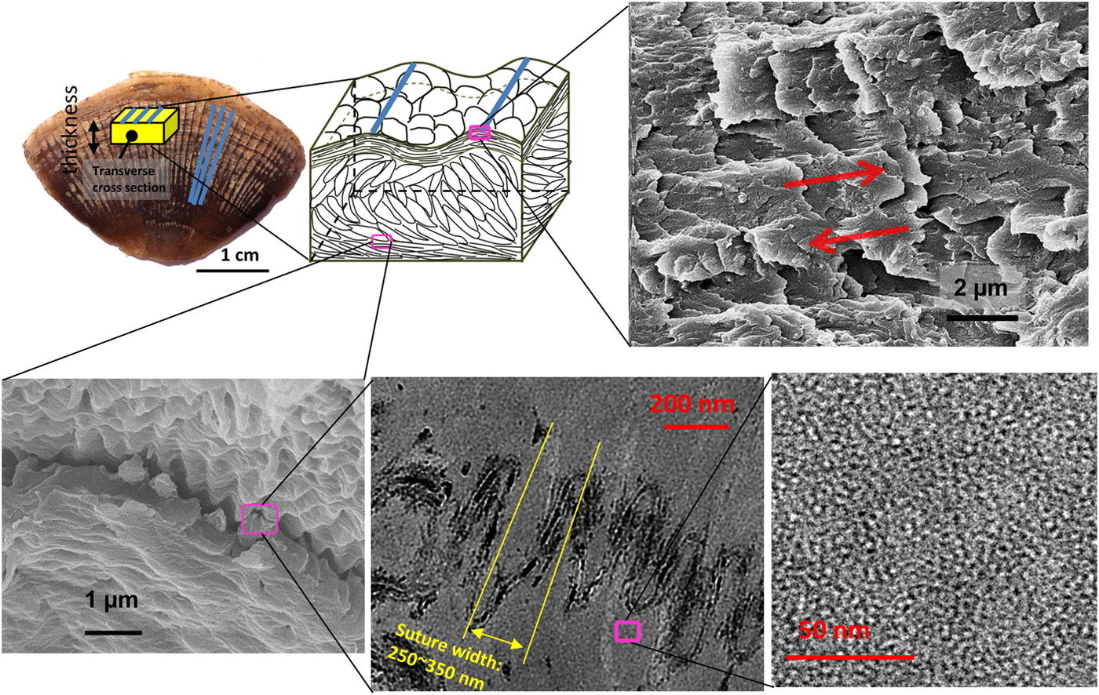
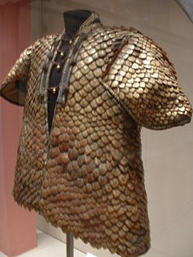
Ferae: Pholidota

Slide 4
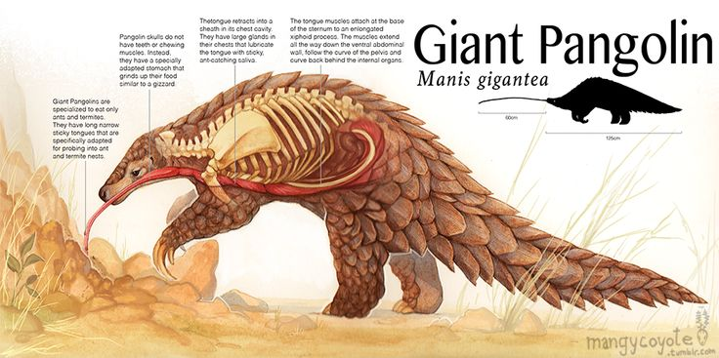
Ferae: Pholidota

Slide 5
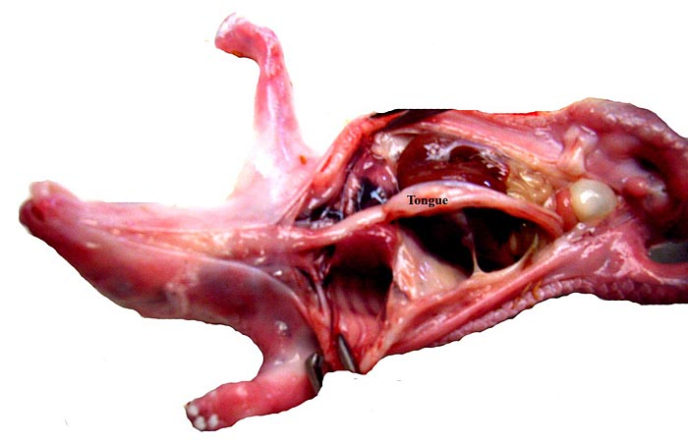
Ferae: Pholidota

Slide 6
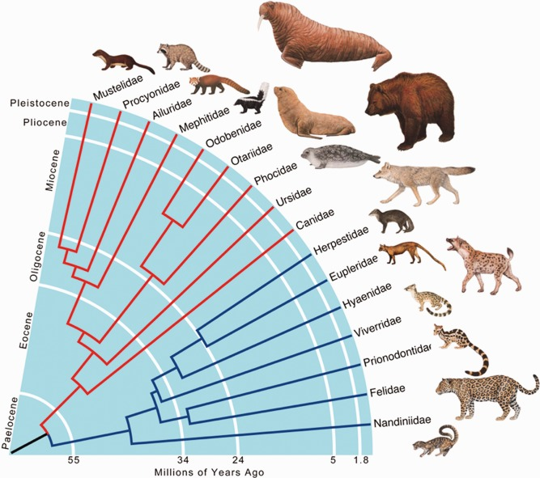
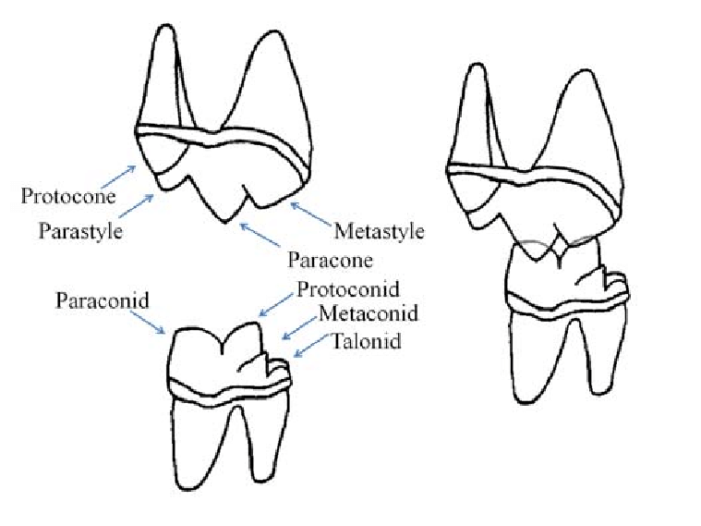
Ferae: Carnivora

Slide 7
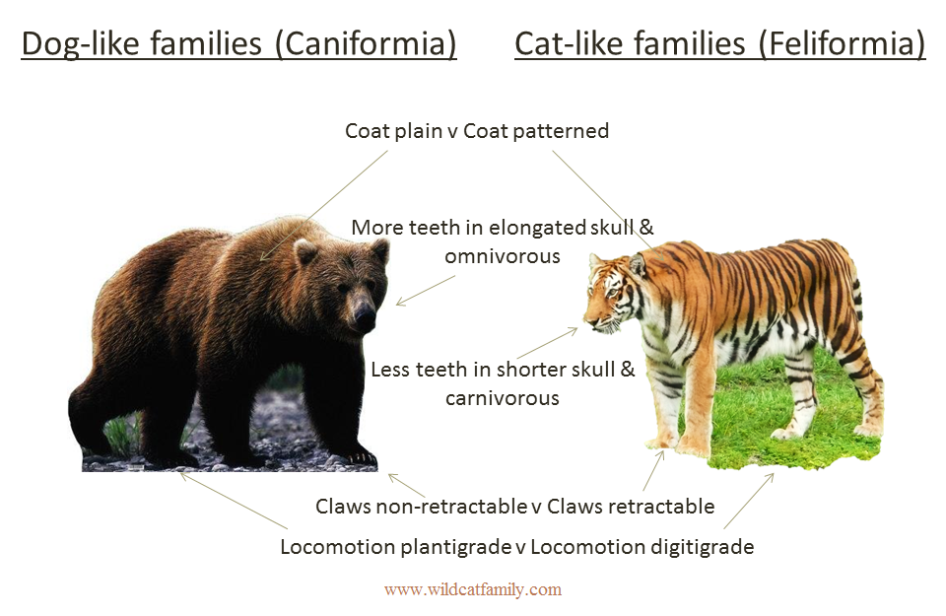
Ferae: Carnivora
Notes:
These are IN GENERAL. Major exceptions to all examples!

Slide 8
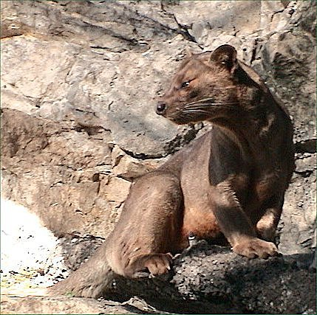
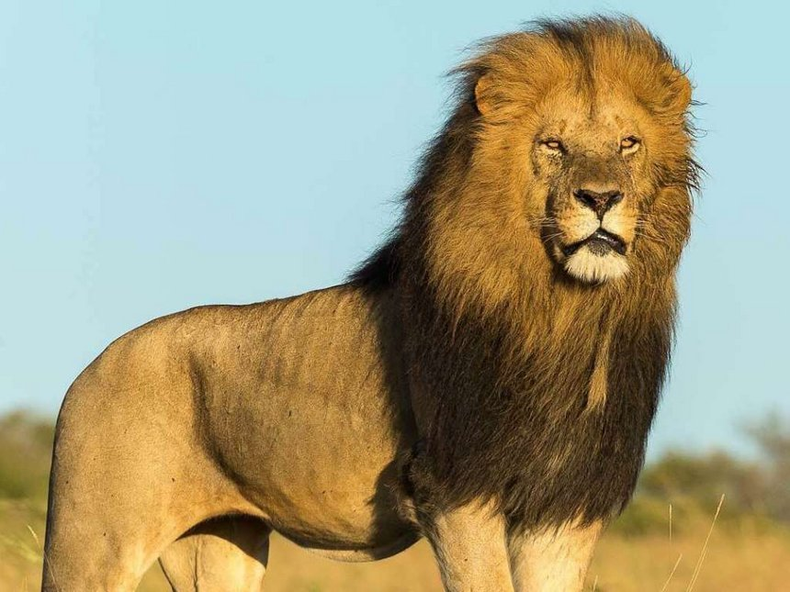
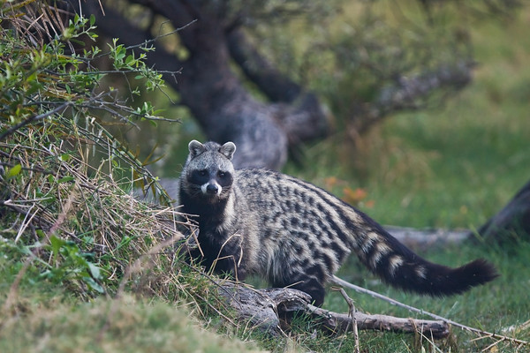
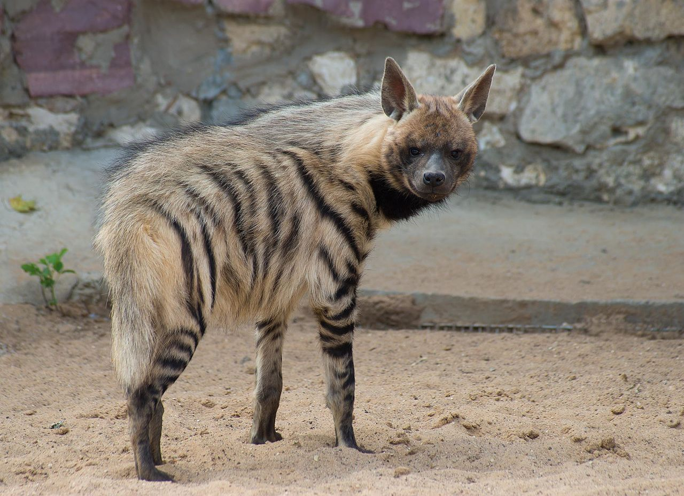
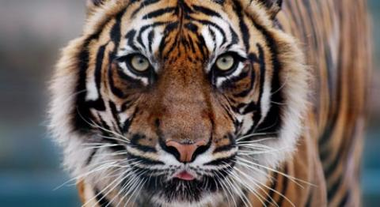
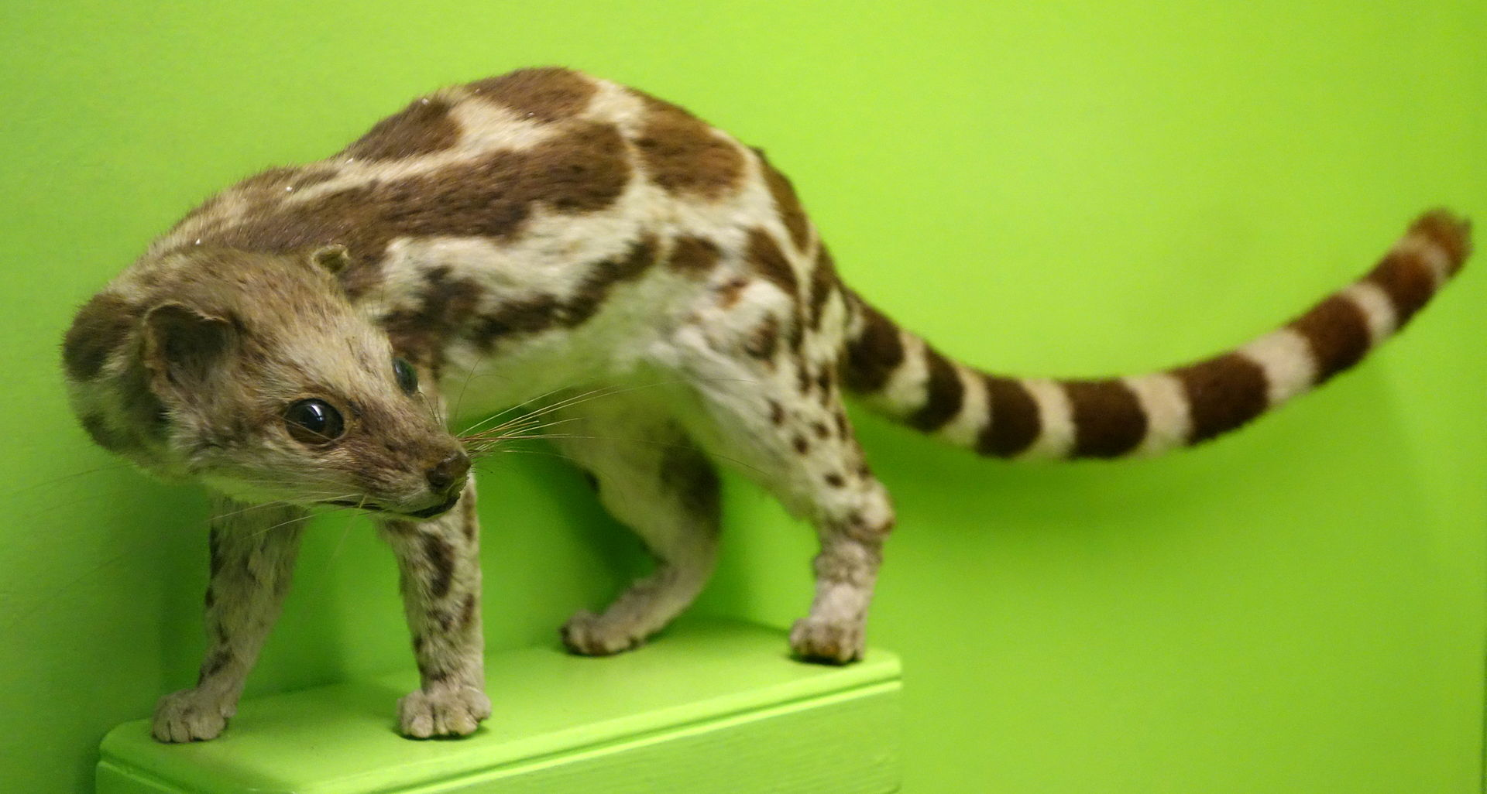
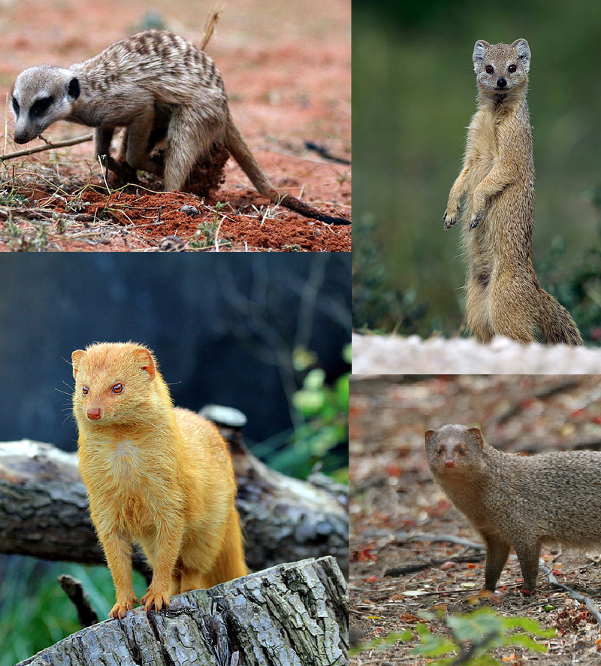
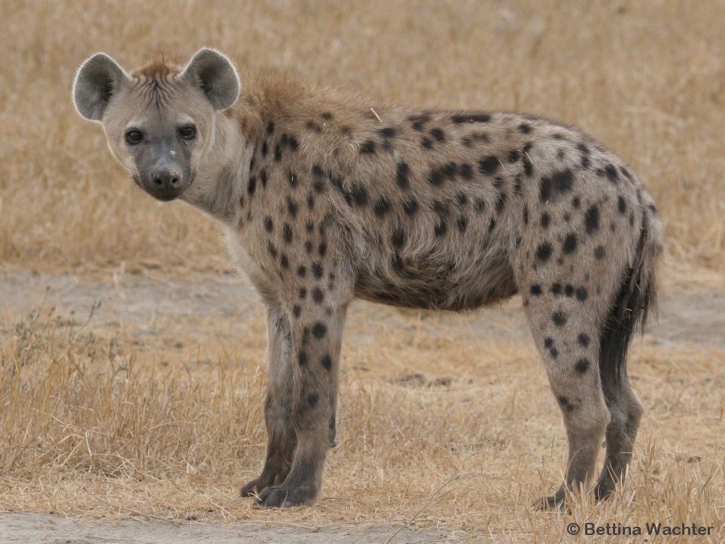
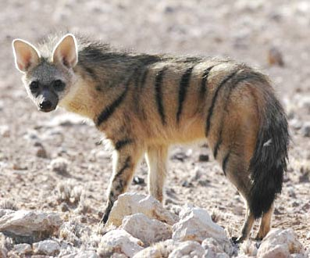
Ferae: Carnivora: Feliformia
Notes:
Viverridae = civets (top left)
Herpetidae = mongoose (bottom left)
Hyenas (middle column)
Cats (between hyenas and euplerids)
Euplerids =Malagasy mongoose (fossa) (top right)

Slide 9
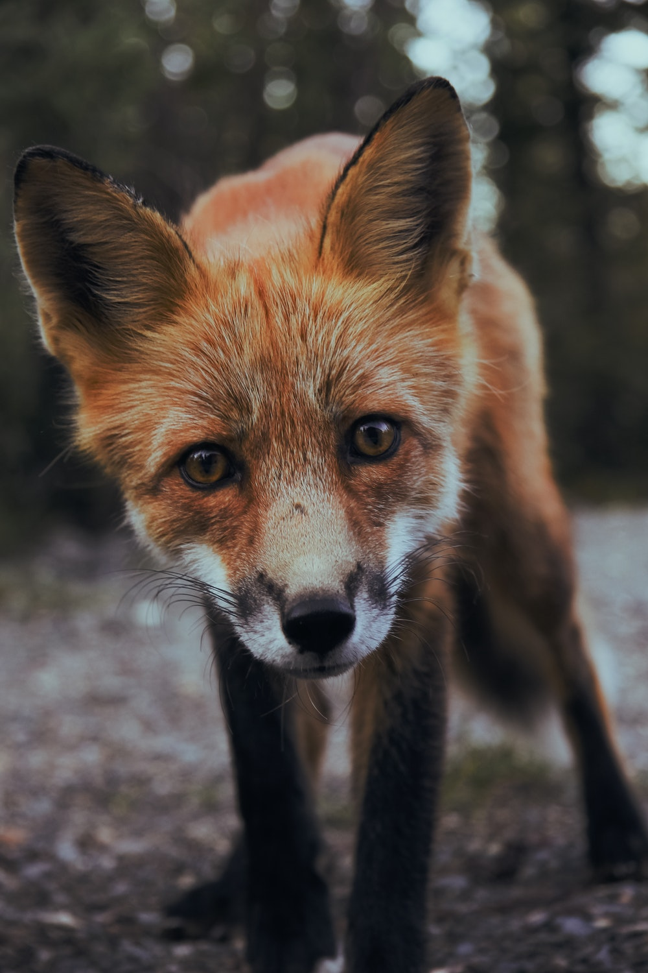
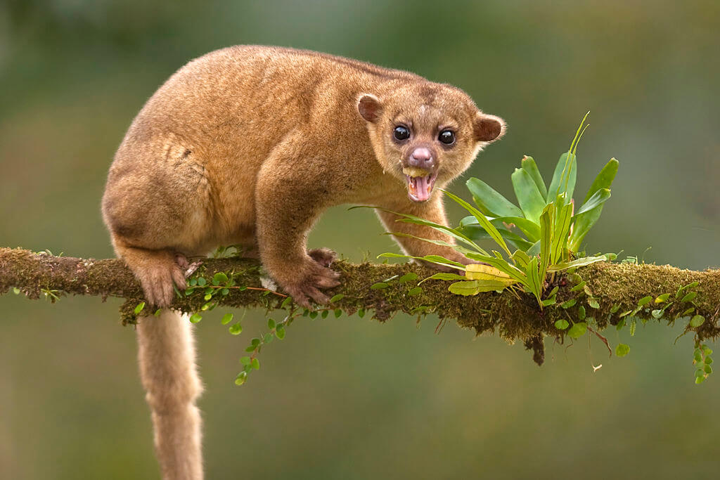
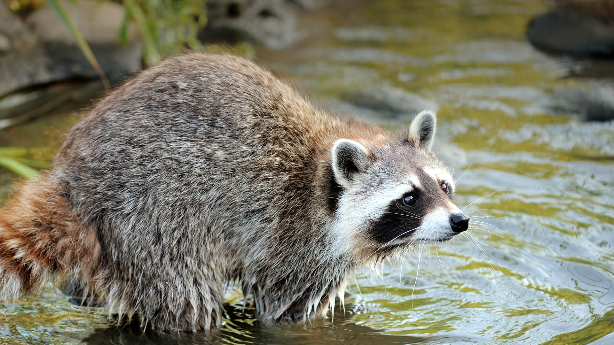
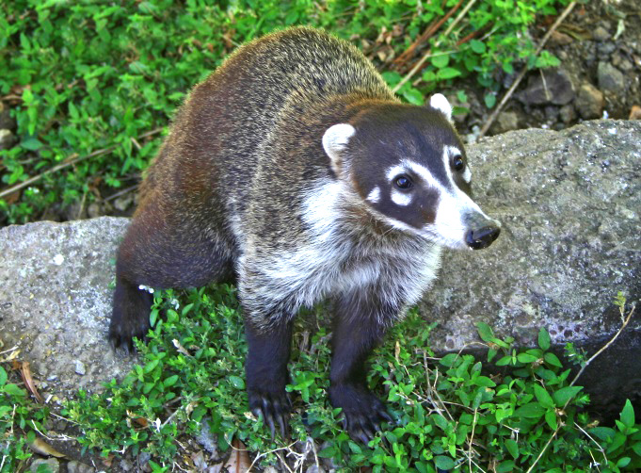
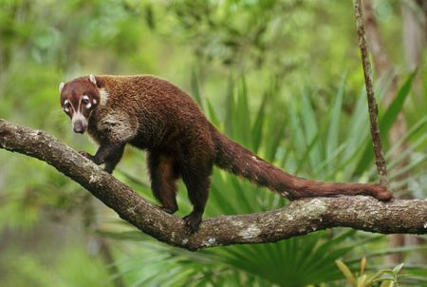

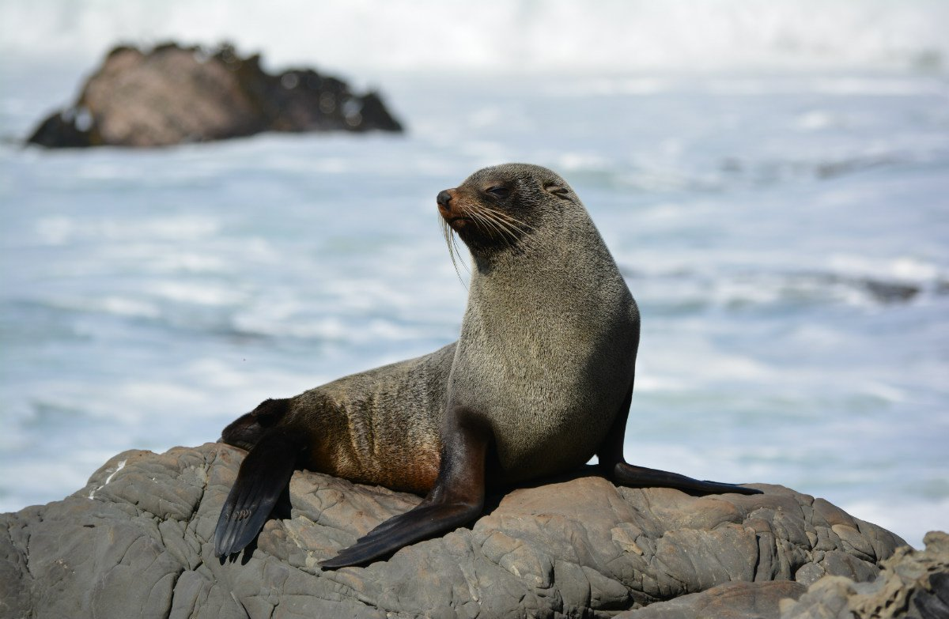
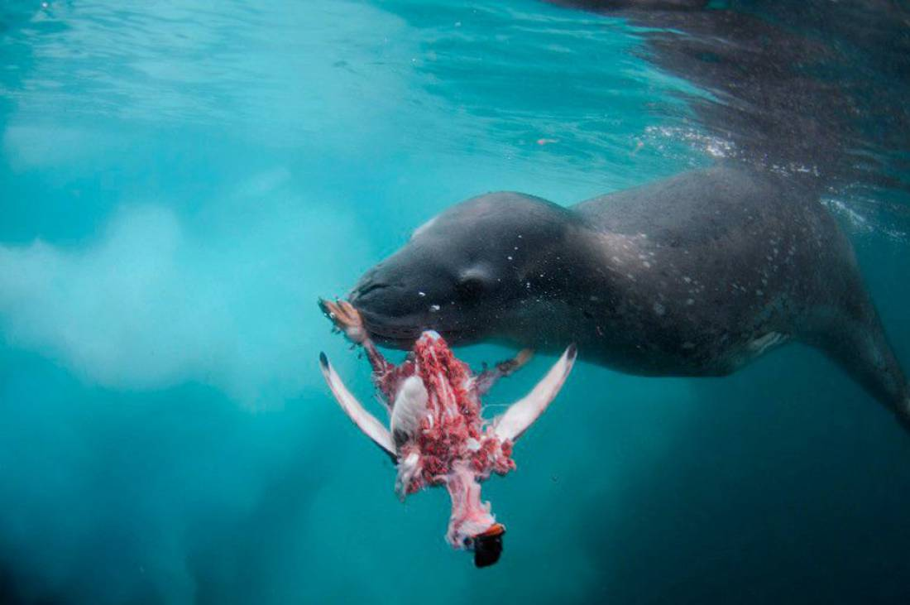
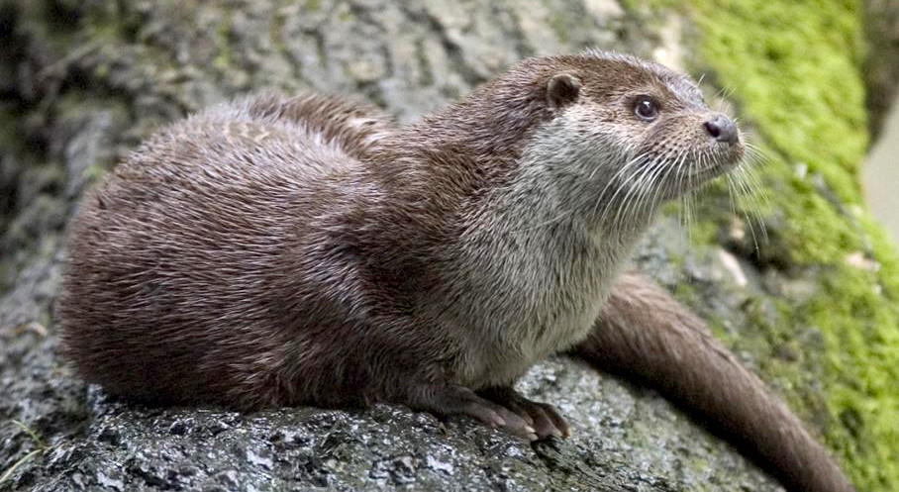
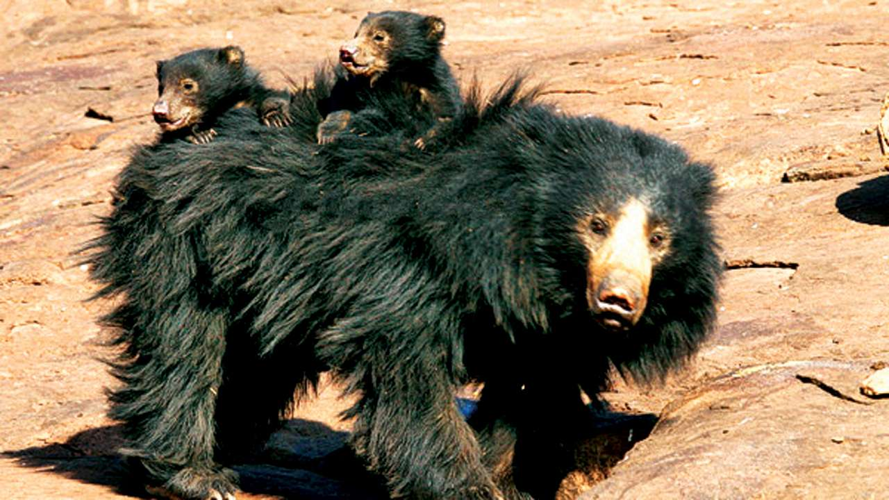
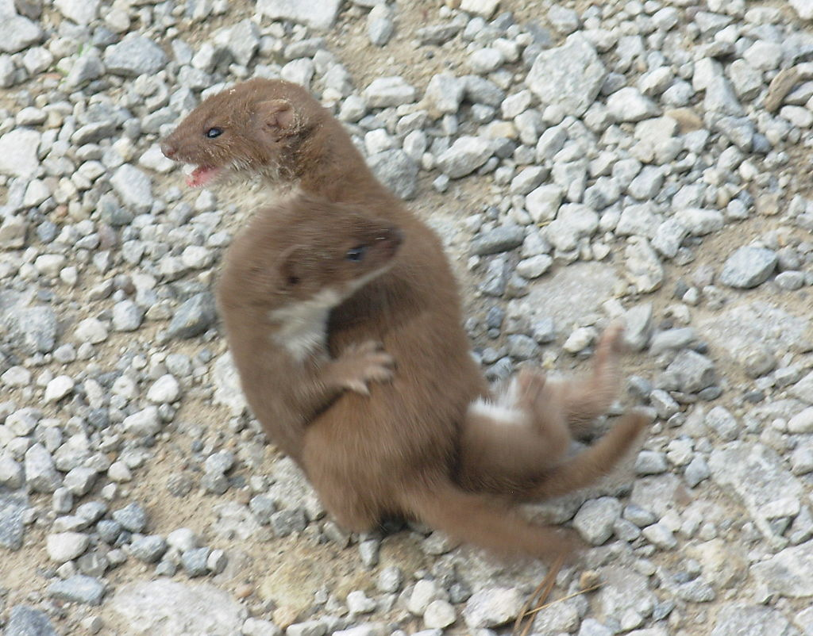
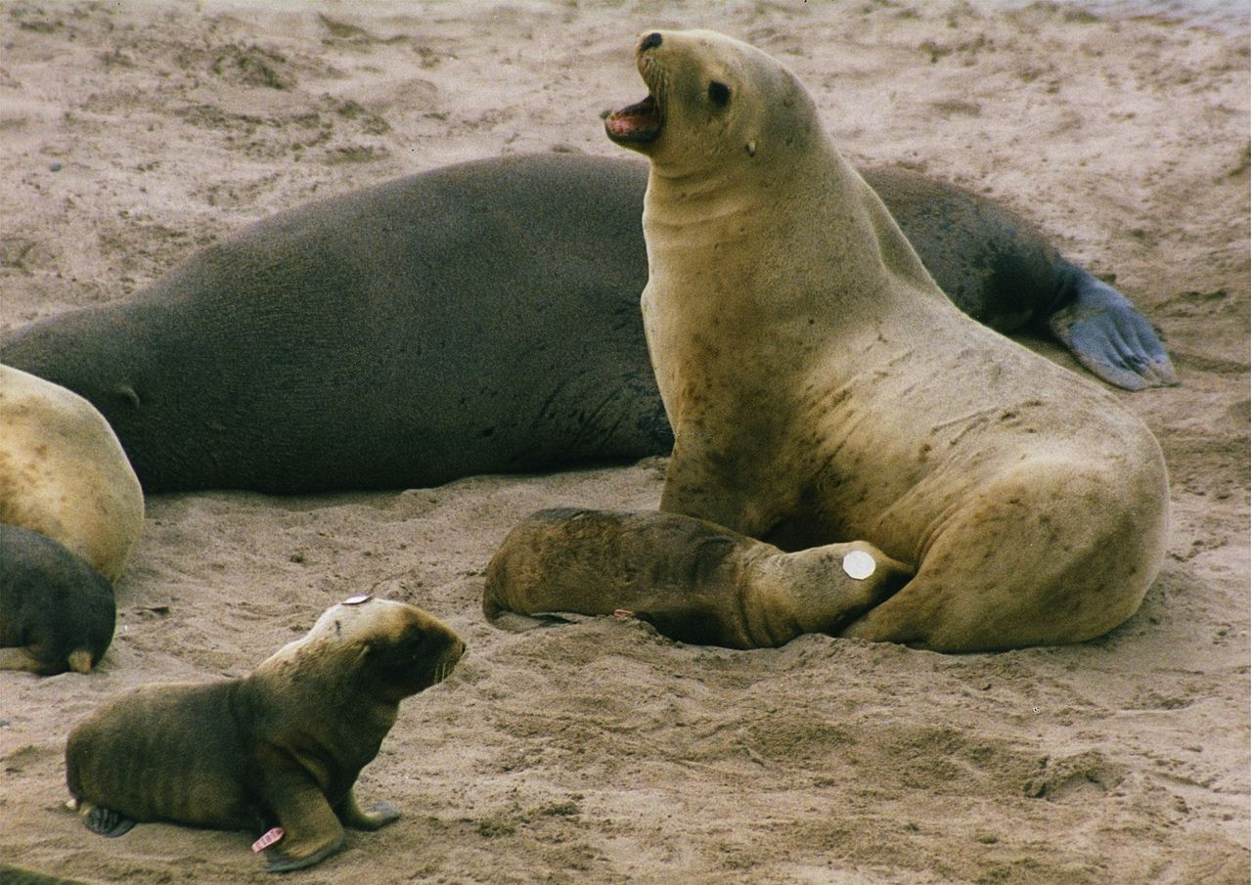
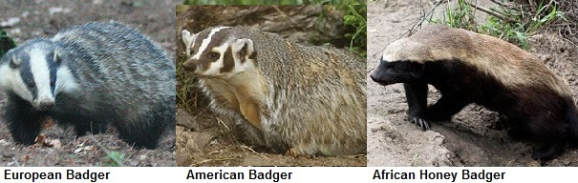
Ferae: Carnivora: Caniformia (~165 sp)
Notes:
Dogs, seals, bears, weasels, raccoons

Slide 10
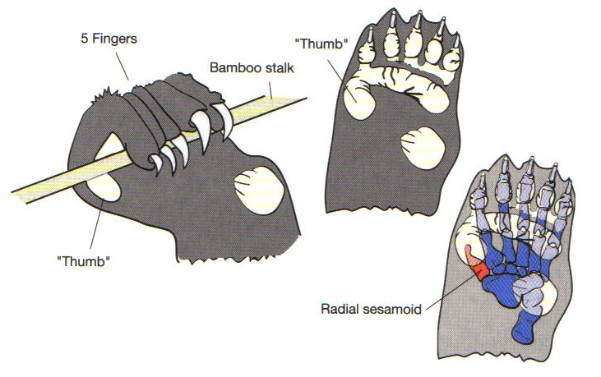
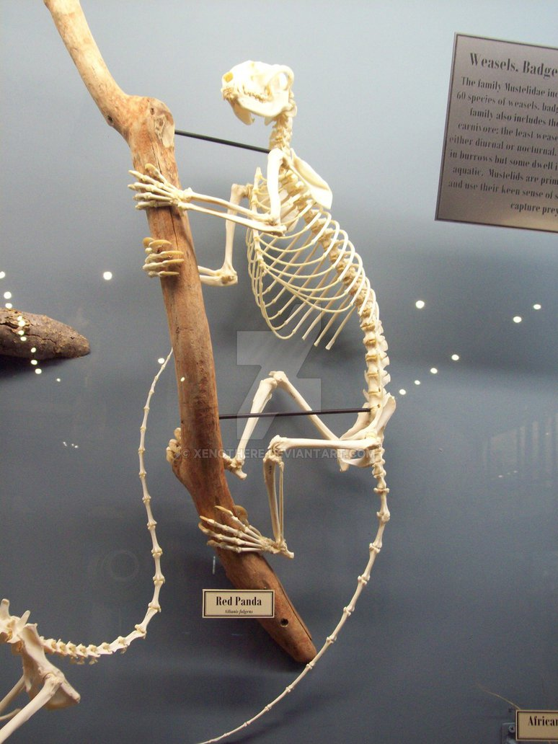
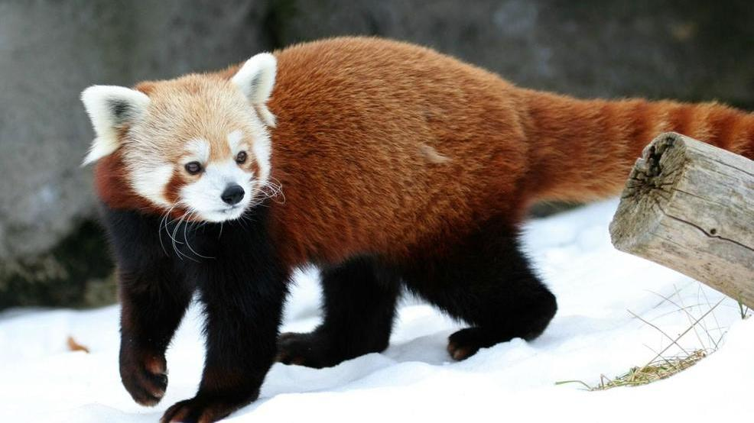
Ferae: Carnivora: Caniformia

Slide 11
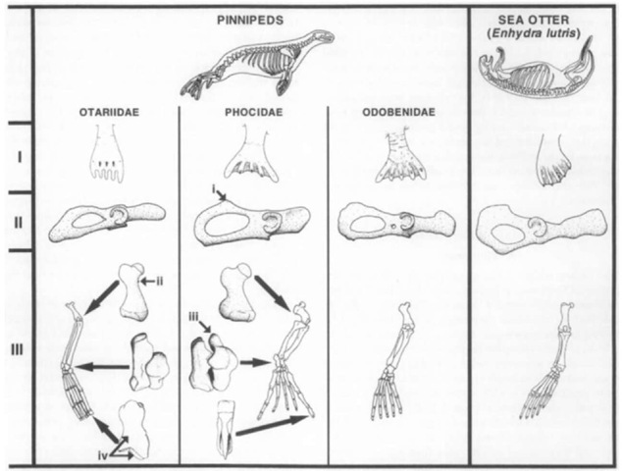
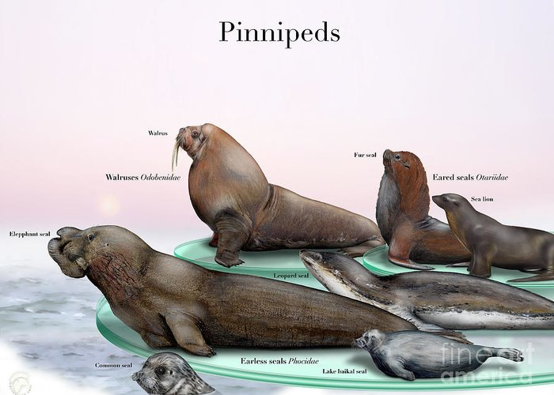
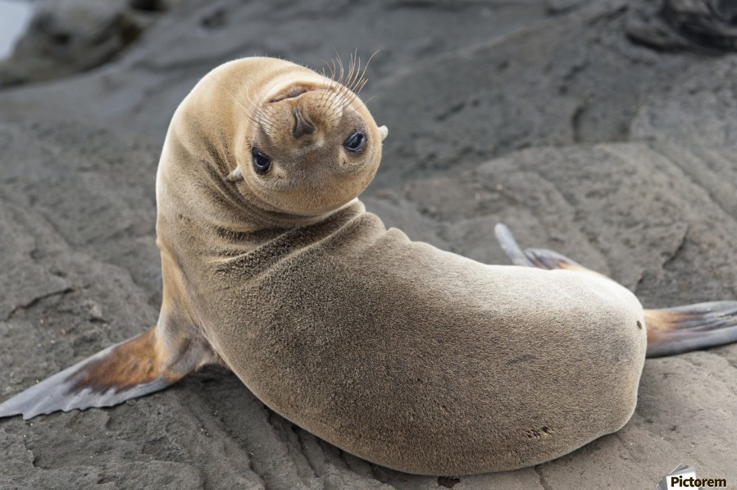
Ferae: Carnivora: Caniformia: Pinnipeds

Slide 12
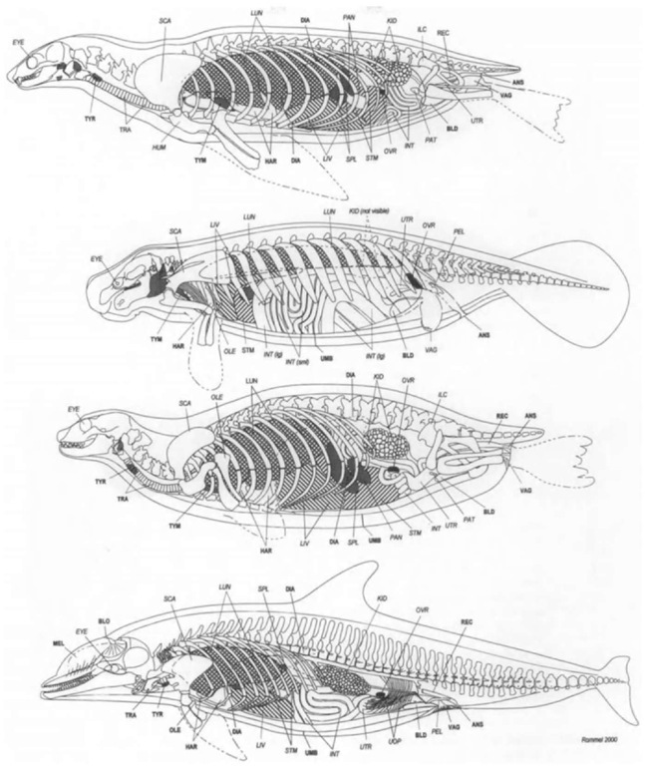
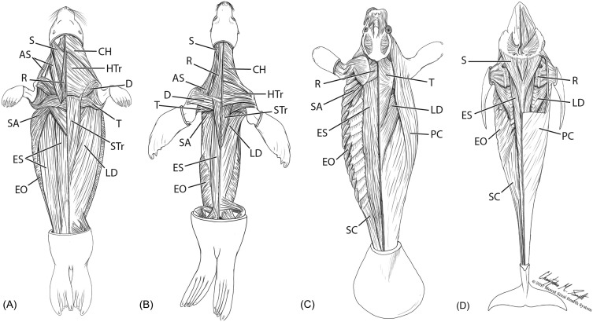
Returns to the Ocean!
Notes:
Pinnipeds

Slide 13
Returns to the Ocean!

Slide 14
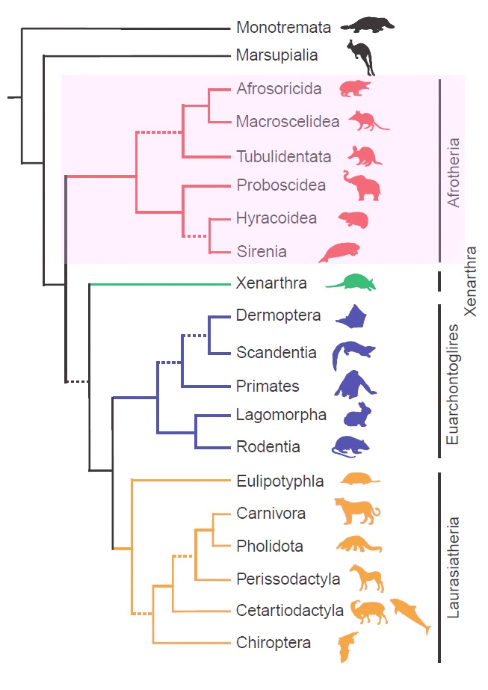
Euarchontaglires
Archonta
Glires

Slide 15
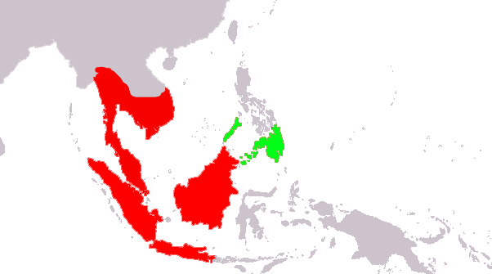
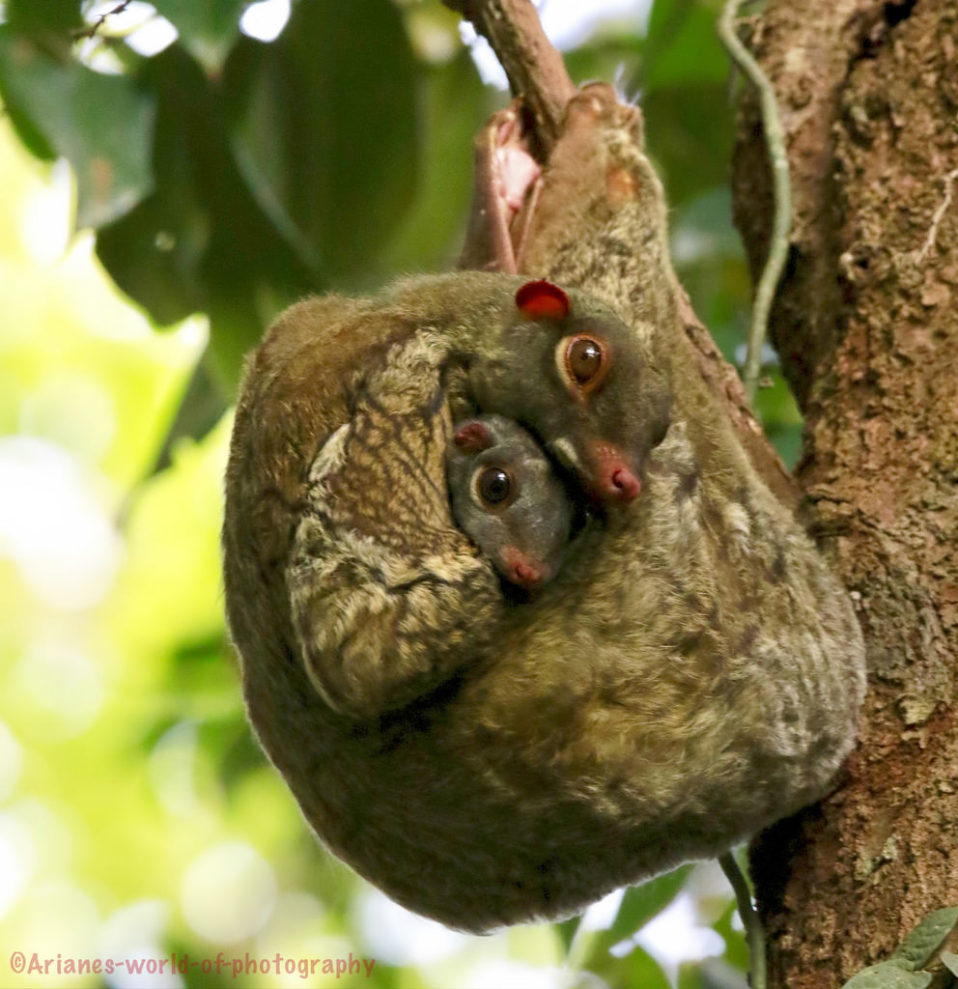
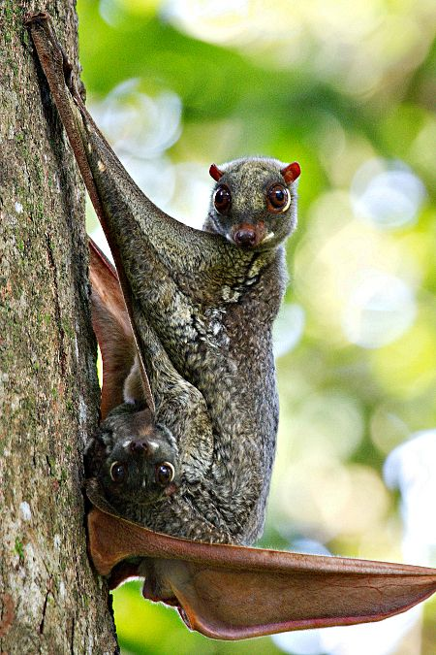
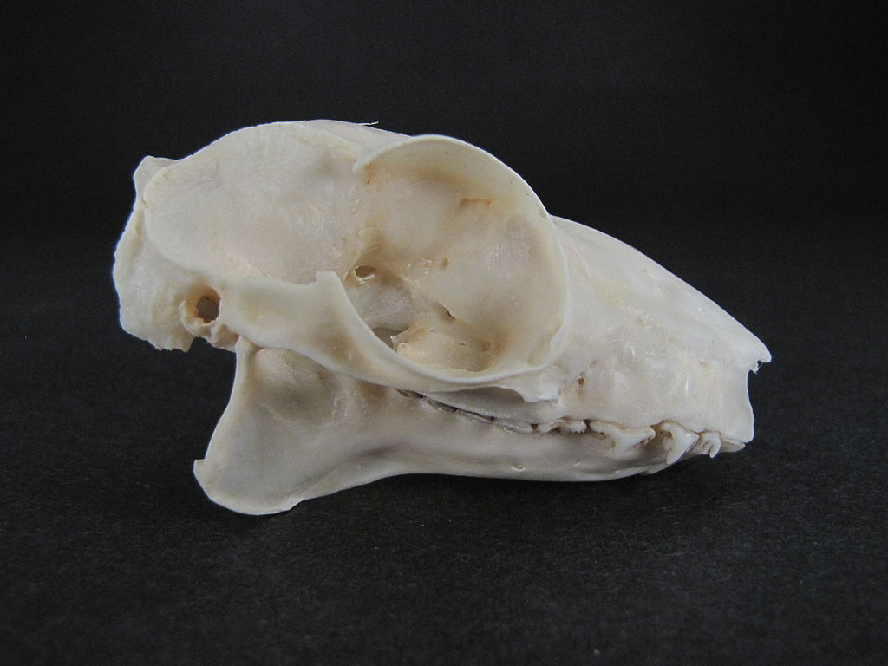
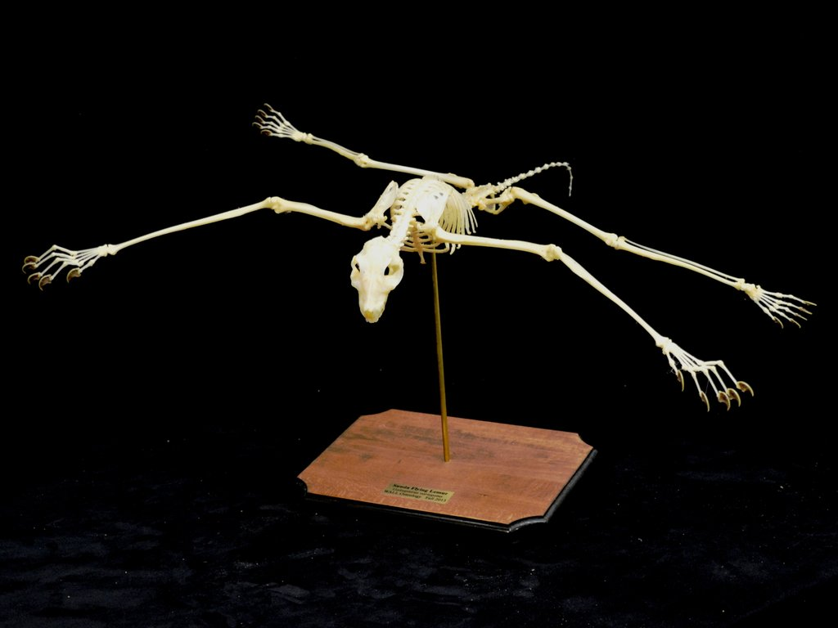
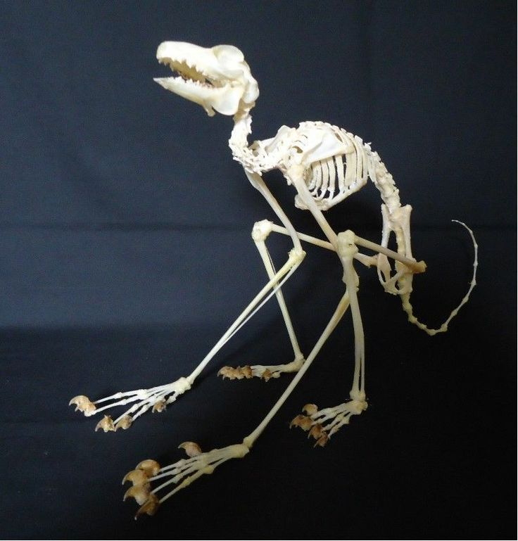
Archonta: Dermoptera (2 species)
Notes:
Tooth comb

Slide 16




Archonta: Scandentia (20 sp)

Slide 17

Archonta: Primates! (~650 species)

Slide 18

Archonta: Primates!

Slide 19











Archonta: Primates! Strepsirrhini (~150 species)
Lemurs, Lorises & Bushbabies
Notes:
Vitamin c

Slide 20


Archonta: Primates! Strepsirrhini
Lemurs, Lorises & Bushbabies
Notes:
Vitamin c

Slide 21

Archonta: Primates! Strepsirrhini
Notes:
Vitamin c
Note extreme extension of back during leap. Bushbabies use energy stored in elastic fibers and powerful extension to aid in their leap.

Slide 22




Archonta: Primates! Strepsirrhini
Tooth comb & tapetum lucidum
Notes:
Vitamin c

Slide 23


Archonta: Primates! Haplorrhini: Tarsiers (~ 7)

Slide 24


Archonta: Primates! Haplorrhini: Tarsiers (~ 7)
Only fully carnivorous primate
No tapetum lucidum

Slide 25

Archonta: Primates! Haplorrhini: Tarsiers (~ 7)
Only fully carnivorous primate
No tapetum lucidum
Notes:
Reflective structure to the choroid layer

Slide 26

Archonta: Primates! Haplorrhini: “Simians”

Slide 27






Archonta: Primates! Haplorrhini: Platyrrhini (~200 species)
“Flat nose” monkeys
New World

Slide 28




Archonta: Primates! Haplorrhini: Catarrhini

Slide 29

Archonta: Primates! Haplorrhini: Catarrhini

